Slide 1
FBLA States: Important Info
March 24-27, 2023
Orlando, FL

Slide 2
March 24 Timeline
9 :15 - YHS students DUE at FSCJ Bean Center (Yulee)
9:30 - bus leaves FSCJ for Orlando
12:15 - lunch stop (Seminole Town Center Mall Food Court)
1:45 - report back to bus/ depart for Orlando
2:40 - arrive at Hilton Orlando

Slide 3
3 important travel tips
1
Life 360
2
International Dr
3
Groups of 2 or more
All YHS students will install and use life 360 while on this trip.
YHS chaperones as well as your parents/guardians MUST be added to the circle for the DURATION of this trip. This is non-negotiable.
Students ARE NOT ALLOWED to travel on International drive WITHOUT the accompaniment of a chaperone.
Students must travel in groups of 2 or more.
Send remind message to advisors to request permission (usually granted)
Or ask in person

Slide 4
Competition FBLA Dress Code
MALES
Business suit with collared dress shirt and necktie; or
Sport coat, dress slacks, collared dress shirt, and necktie; or
Dress slacks, collared dress shirt, and necktie.
Dress shoes and dress socks are required.
A banded collar shirt may be worn only if a sport coat or business suit is worn.
FEMALES
Business suit; or
Business pantsuit (must include a jacket and pants); or
Business dress; or
Skirt with blouse or sweater.
Closed toe and heel business dress shoes are required.
MALES AND FEMALES
No jewelry in visible body piercing, other than ears, on men or women
Rules

Slide 5
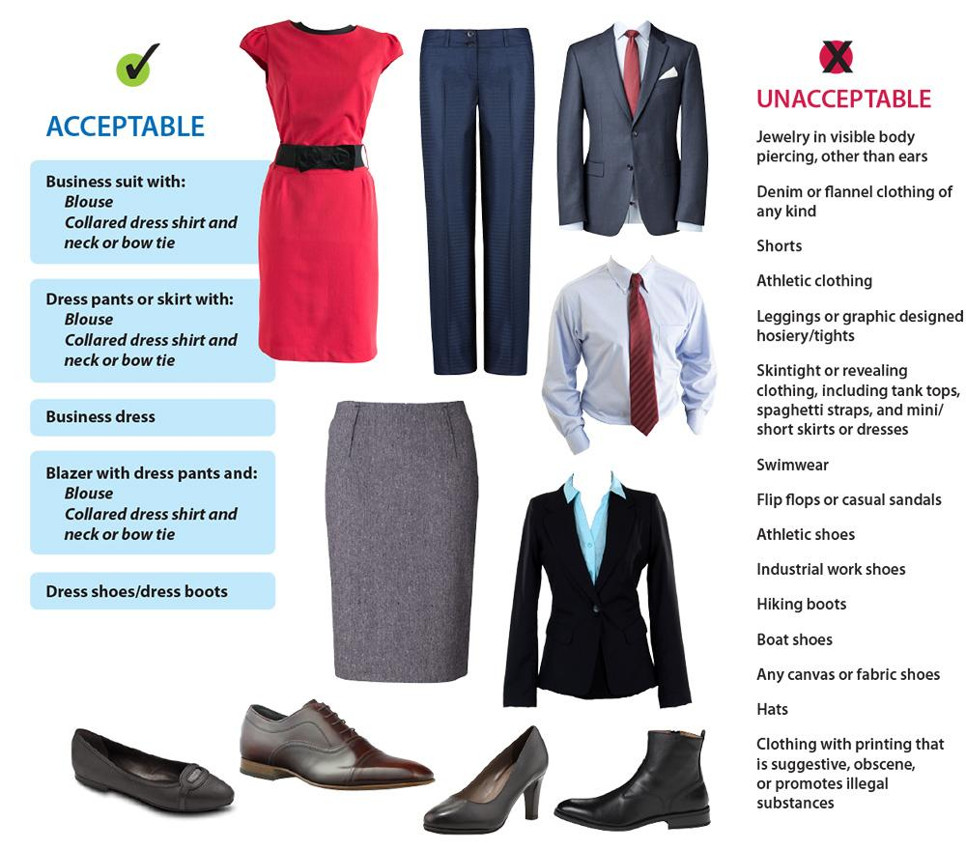
Quick Guide
Do vs Don’t

Slide 6
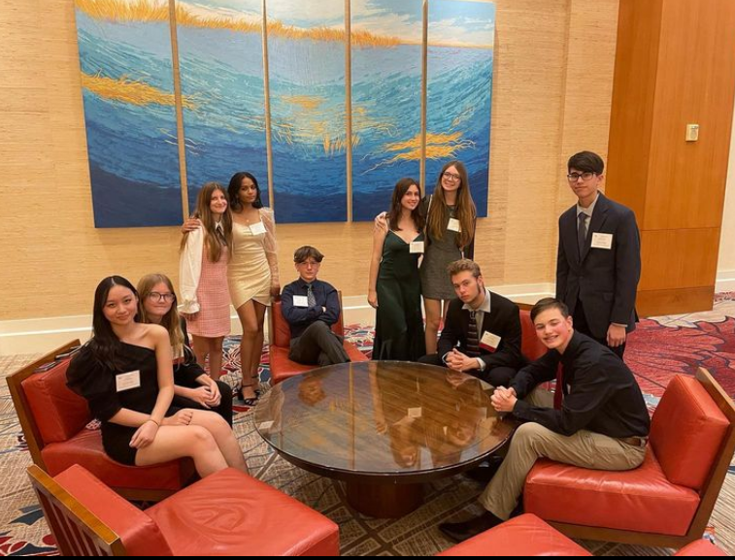
Awards Attire
Professional dress as listed above; or
Semi-formal or formal attire

Slide 7
What to Pack
Wear your State’s tee on March 24th
2 full competition outfits
Gentlemen DO NOT forget to bring at least 1 tie!!
1 awards outfit
Dress shoes
Appropriate sleepwear (you’re sharing a room, bring pj’s)
Accessories as needed
Makeup/Skincare/health needs
Electronics and chargers
This is the most forgotten item, trust me you don’t to purchase a charger at the hotel they are super expensive!

Slide 8
Outfit Checks
You are required to send your planned competition outfits into to the Fashion Committee for pre-approval.
This is just to ensure we do not violate any competition rules and that everyone will be able to participate.

Slide 9
Mani/ Pedi Colors
Please note the following guidelines :
If I can see your nail color from space and/or it’s black light activated ; it’s not competition appropriate.
A good rule of thumb is to ask yourself could I wear this in a boardroom Infront of a group of investors and be taken seriously?
If you are unsure send an image of the color (or style) to Mrs. Litchfield for approval

Slide 10
Events
Be sure to check the schedule that came with your permission slip for States.
If you need another copy of this let us know.
Some of you have events on March 24th starting around 5pm - be sure that you can access your competition wear right away; as you should probably change within 1 hour of us arriving.

Slide 11
Once we are there
Download the competition app, all competition updates will be posted there
Drop your stuff in your room and then meet in the lobby so we can show you where everyone will be competing
On events - do your best; we’re always going to support you.
Workshops & General Sessions - you are required to attend these
Other than that - have fun, make friends there will be 5,000+ students at this event make the most of it.

